Slide 1
What are animations?
Mr Mack 2021

Slide 2
What are animations?
Congrats on learning how to make drawings with your programming skills! Now you'll learn how to turn those drawings into animations, with only a few more lines of code.
First, though, let's talk about what an animation is. How could you make an animation without programming?
You could make a bunch of drawings on pieces of paper, then flip those pieces of paper so the drawings go by in a sequence, and it would look like an animation. Well, it'd look like an animation if those drawings were each just a little bit different from each other. For example, check out this pencil-and-paper animation of a car driving down the street:

Slide 3
What are animations?
It probably took a while to make that animation, though, and well, it's not that great. It's pretty shaky and it has no color at all.
But now we live in the future! We can make a better animation programmatically in a few minutes with only a dozen lines of code, like this one:

Slide 4
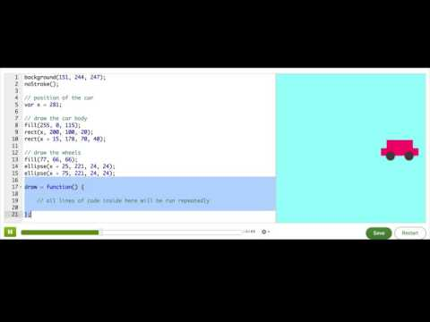
Making animations

Slide 5
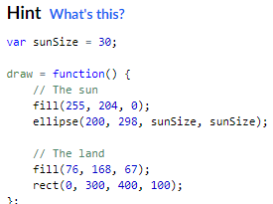
Practice: Exploding Sun
Right now, this program just draws a sun that never moves (boring!). To prepare to animate it, make a draw() function and move all the shape drawing commands inside of it.
Be careful about how you write the (parenthesis) and {curly braces} after draw = function. They have to look like the hint code, you can't miss any or the computer will get confused.
Prepare to animate!

Slide 6
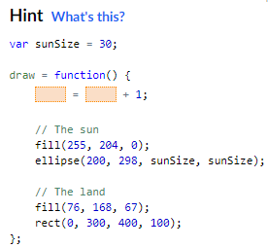
Practice: Exploding Sun
Now, to make the sun get bigger, add 1 to the sunSize variable inside the draw function.
Tip: do it using the same technique we used on the x variable from the last talk-through, except this time you should use it on sunSize instead of x.
Remember you can press 'F5' to restart the animation.
Explode the sun!

Slide 7
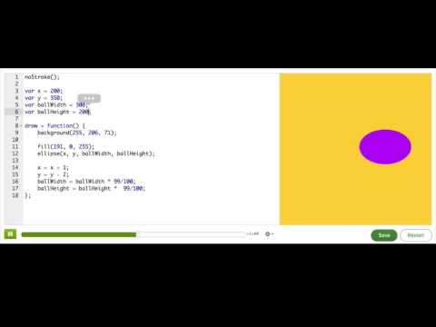
Incrementing shortcuts

Slide 8
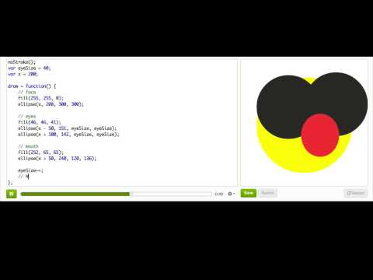
A shorter shortcut

Slide 9

Practice: Parting Clouds
In this challenge, you'll use your magical programmer powers to create a cloudy sky, and then animate it into a bright and sunny sky.
Start off by changing the position of the clouds so that they cover the sun, but still let a little sun peek out.
Hint: try changing the value of the leftX and rightX variables.
Cover the sun!

Slide 10

Practice: Parting Clouds
The clouds are hiding the sun now, and we want to animate them moving in opposite directions away from it. Make it so that the left cloud moves 1 pixel to the left in each frame, and the right cloud moves 1 pixel to the right. Remember you can click Restart to re-run your program.
Hint: Use the shortcuts you learned in the last 2 talk-throughs to add or subtract 1 to the leftX and rightX variables.
Part the clouds!

Slide 11

Practice: Parting Clouds
Let's make it so the clouds are running away from a sun that's getting bigger and BIGGER. Increment the sun radius by 2 pixels in each frame.
Grow the sun!

Slide 12
Challenge: Shooting star
Decide what side of the canvas you want the star to start from, the top, bottom, left or right, and position your star there.
Decide what direction you want the star to move in. Change the variables inside draw so that the star moves the way you wanted.
Add another star or other shape, and animate it going in a different direction.
Bonus: Change the star into a different shape, or have it shoot out of a cannon.
Bonus: Add a backdrop, like a starry night or skyscrapers.
Now that you've learnt the basics of animation with variables, make a shooting star! We've started off this program with just a star positioned using 2 variables, and it's up to you to decide how to animate it. Here are the steps we suggest:

